Slide 1
DATA 824 Final Project Shiny App
Brian Nomura
Department of Biostatistics
University of Kansas Medical Center
July 22nd, 2025

Slide 2
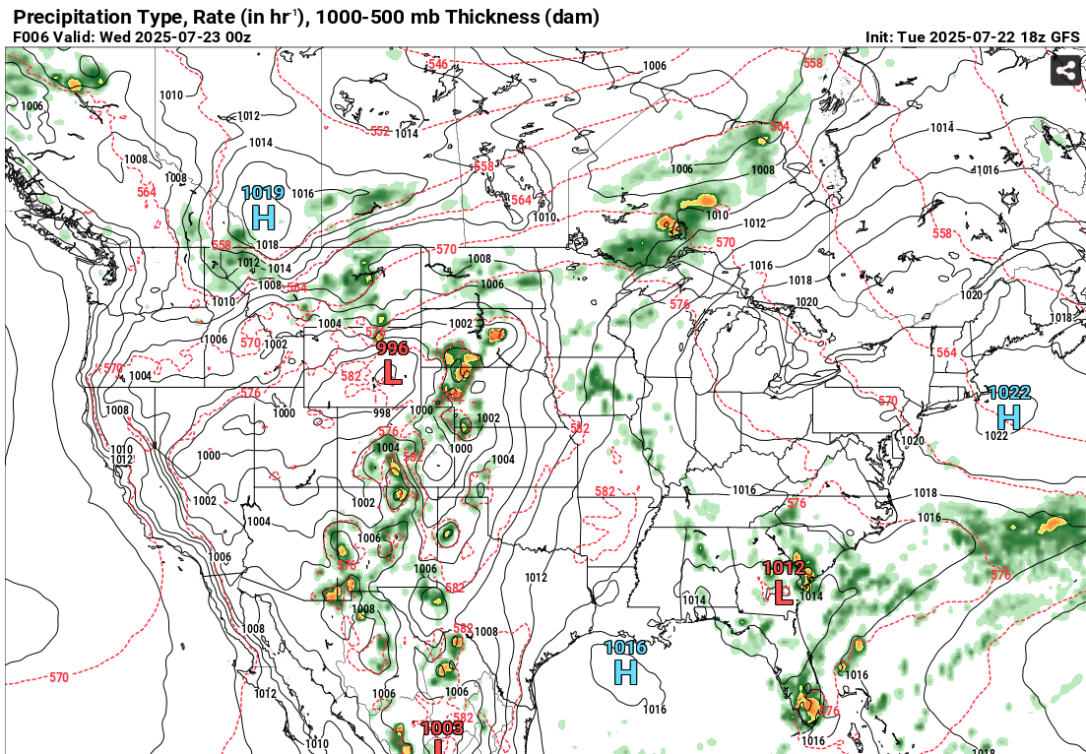
Visualizing Tornado Climatology in the United States
The purpose of this project will be to explore data provided by a specialized division of the National Oceanic and Atmospheric Administration (NOAA) known as the Storm Prediction Center, or SPC. The SPC is the government entity responsible for forecasting and issuing severe weather watches, as well as collecting reports/data to complete surveys on severe storm events. The day after a severe weather event occurs, a survey team will attempt to “reconstruct” the storms life cycle and collect necessary research data (2, National Weather Service).
The dataset being examined with this Shiny App covers over 70 years (1950-2023) of confirmed tornado reports. The app explores a variety of different data representations through R visualizations, to show how tornado activity varies by location and magnitude.

Slide 3
Introduction
In the field of atmospheric science, tornadogenesis (how and why a tornado forms) continues to remain an unexplainable phenomenon. Forecasting methods trying to predict tornadic storms have greatly improved over the past 70 years; however, there’s still a large amount of uncertainty when it comes to figuring out why some supercells produce tornadoes and some don’t. Studying and gaining a better understanding of these storms will help lead to more accurate forecasts, advanced warnings with higher lead times, and hopefully a reduction in the loss of life.
The Fujita scale, of F-scale, was created by Theodor Fujita in 1971. This scale rated tornadoes from F0 (weak) to F5 (extreme) with estimated wind ranges based on the destructive path of the tornado (3, Storm Prediction Center). One glaring issue with this scale is that you could have a large, strong tornado in an open field that does little to no damage, versus a weak, short-lived tornado that hits a highly populated city. The large tornado would be given a lower F-scale rating, while the weaker tornado would be given a higher F-scale rating since more damage was caused. To remedy parts of this problem, along with advances in technology, the Enhanced Fujita scale was introduced in 2007. The EF scale, which is still used currently, bases its scale on surveys that look at building damage but was redesigned to produce more accurate results. Rather than assigning an F-value based on the fact that a house was damaged, the aspects of the house were also inspected. When the house was built, what materials were used in its construction, and did it have any pre-existing damage beforehand for example.

Slide 4
Variable Name | Data Type | Data Format | Description | Example
Yr | Number | YYYY | Year of report | 1950
Date | Date | MM/DD/YYYY | Date of report | 01/02/2023
Time | Time | HH:MM:SS | Time of report | 11:47:00
St | Character | AA | State of report | AR
Mag | Number | 1 | Magnitude of Tornado (EF-Scale) | 0
Inj | Number | 1 | Number of Injuries | 0
Fat | Number | 11 | Number of Fatalities | 00
Slat | Number | 11.11 | Starting Latitude | 36.73
Slon | Number | 11.11 | Starting Longitude | -102.52
Exploring the Dataset

Slide 5
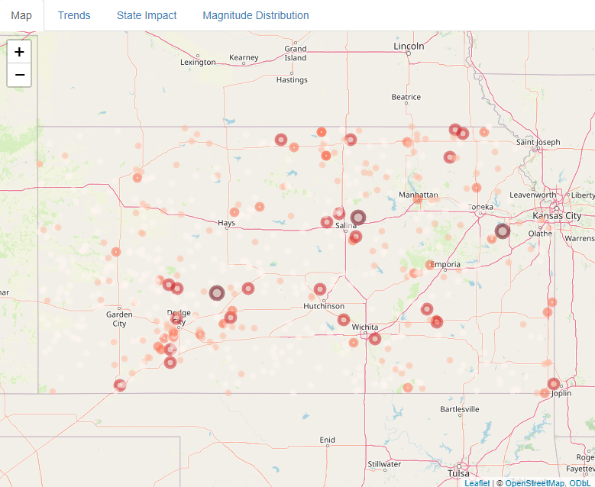
Results and Discussion
The first tab(Map) of the Shiny App lets the user display tornado reports based on State(s) and Magnitude. Multiple states can be selected, and magnitude follows the EF-scale from 0-5.
Magnitude is indicated by circle size and color. A higher magnitude tornado report will have a larger circle and will be darker red.

Slide 6
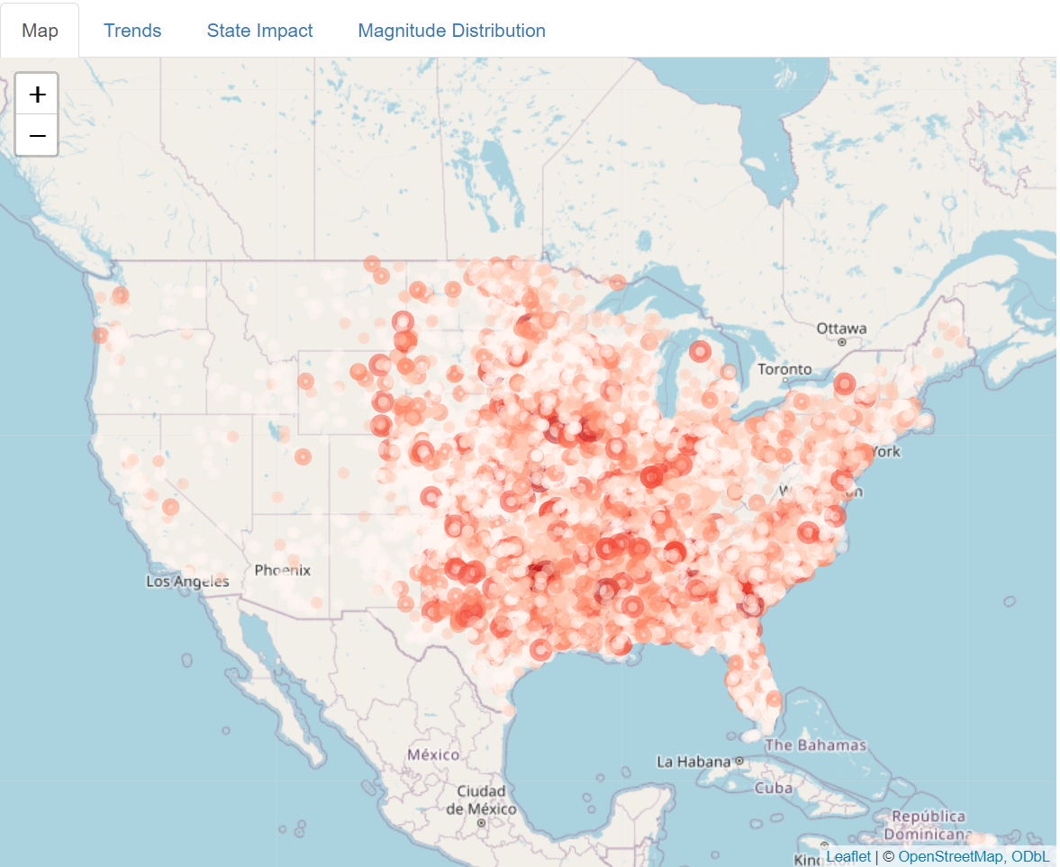
This map shows the tornado reports for every state in the US for the last 10 years of data (2013-2023).
At first glance this map may seem a bit messy and very crowded, but it is able to visualize a very important idea.
The map clearly visualizes that the number of reports and location in the US are correlated. This is due to a combination of how storms form, and availability of atmospheric resources. There is a visible line that follows the Rocky Mountain range from New Mexico, to Colorado, through Wyoming, and up to the Canadian border through Montana.
Lee cyclogenesis causes storm systems to intensify on the leeward (downwind) side of a mountain range. Combining this with south/southeast winds bringing in moisture from the Gulf of Mexico, will lead to an increase in storm activity.

Slide 7
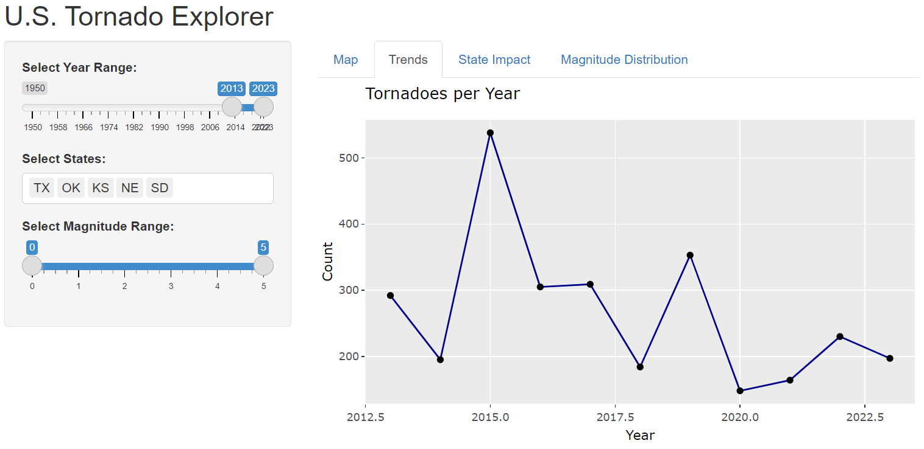
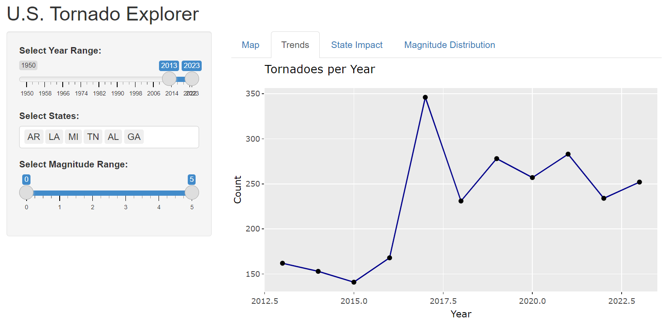
Tornado Alley and Dixie Alley
Using the “Trends” tab of the Shiny App, line charts can be created for a chosen year range and selected states. Using these two charts we are able to compare the total number of tornadoes reported in the 2 most active regions of the United States. Tornado Alley found in the central plains and Dixie Alley found in the southeast.
-These charts allow us to focus on extremely active or non-active years, for further research opportunities. For example, in 2015 Tornado Alley was extremely active with over 500 tornado reports as compared to an extremely in-active Dixie Valley with only around 100 reports.
Tornado Alley – Consists of the States of TX, OK, KS, NE, and SD
Dixie Alley – Consists of the States of AR, LA, MI, TN, AL, and GA
-Further research looking into weather conditions for 2015 would indicate an unusual shift in the jet stream, thus leading to higher storm activity in the central plains and a reduction in storm activity in the southern US.

Slide 8
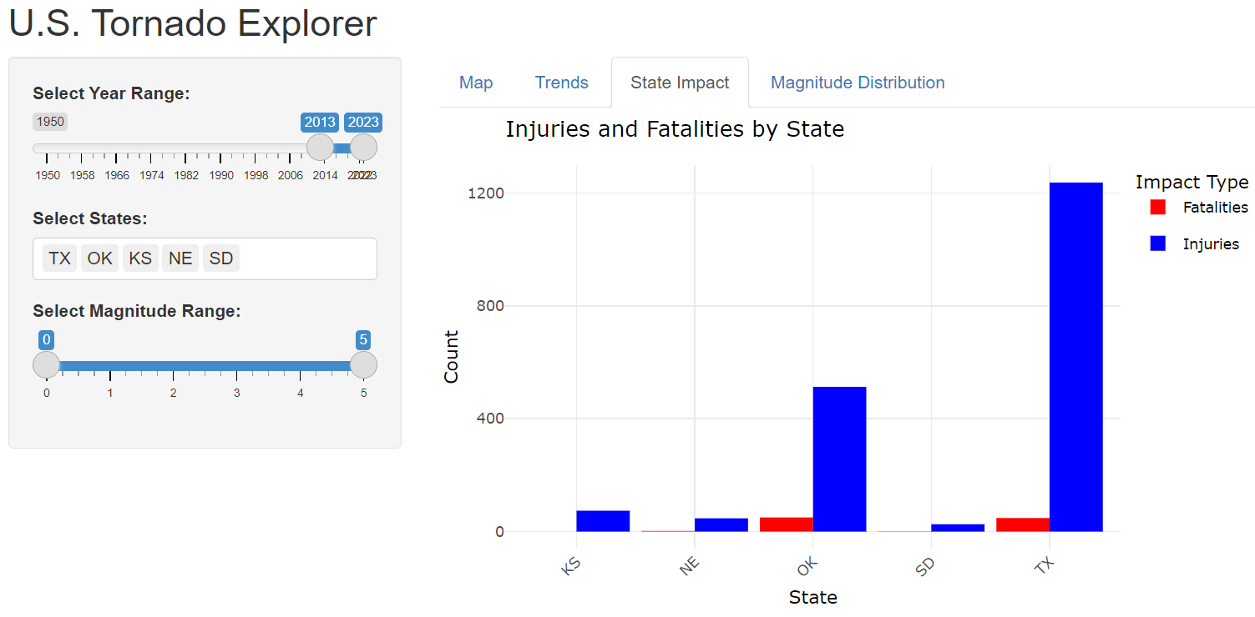
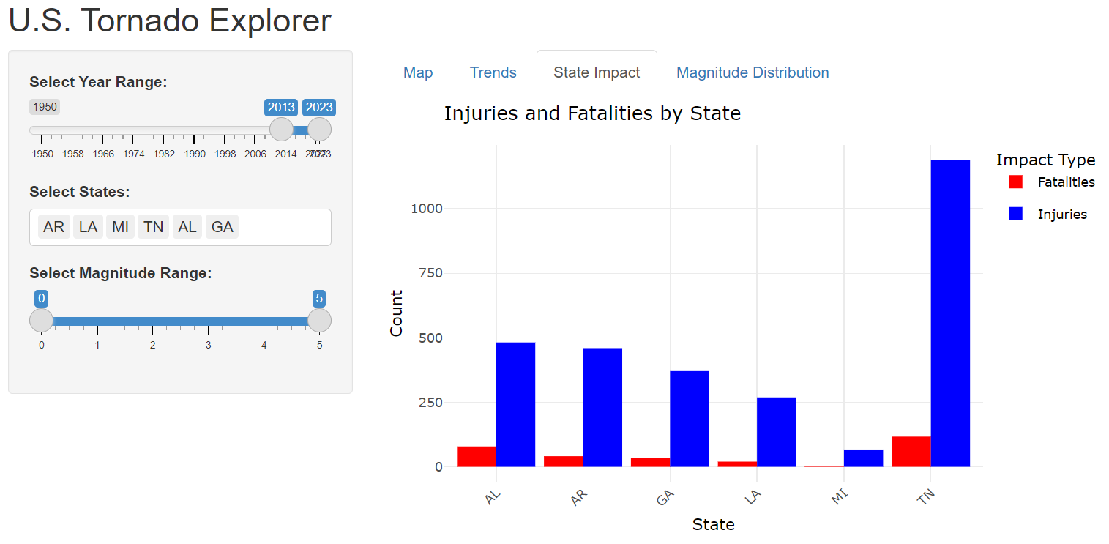
Tornado Alley and Dixie Alley (continued)
Tornado Alley – Consists of the States of TX, OK, KS, NE, and SD
Dixie Alley – Consists of the States of AR, LA, MI, TN, AL, and GA
Continuing the discussion on Tornado and Dixie Alleys, bar graphs have been created using the “State Impact” tab in the Shiny App.
Despite Tornado Alley have a higher tornado report count, the data shows that on average Dixie Alley sees both more injuries and fatalities. Tennessee and Texas are interesting data points on these graphs, they have similar fatality and injury counts; however, Texas is nearly 6.3 times larger in terms of square mileage.
These bar graphs visually show how Tornadoes in Dixie Alley are more prone to causing injuries and fatalities. Dixie Alley has fewer tornado reports, but these tornadoes tend to cause more damage/harm.
The environment in the south plays a major role in this cause. Southern US states tend to be covered with more hills and trees, making tornadoes harder to see and report. Combine this with the fact that storms move faster through this area (an average of 10-20meters/second faster than storms normally found in Tornado Alley), creates shorter warning windows.

Slide 9
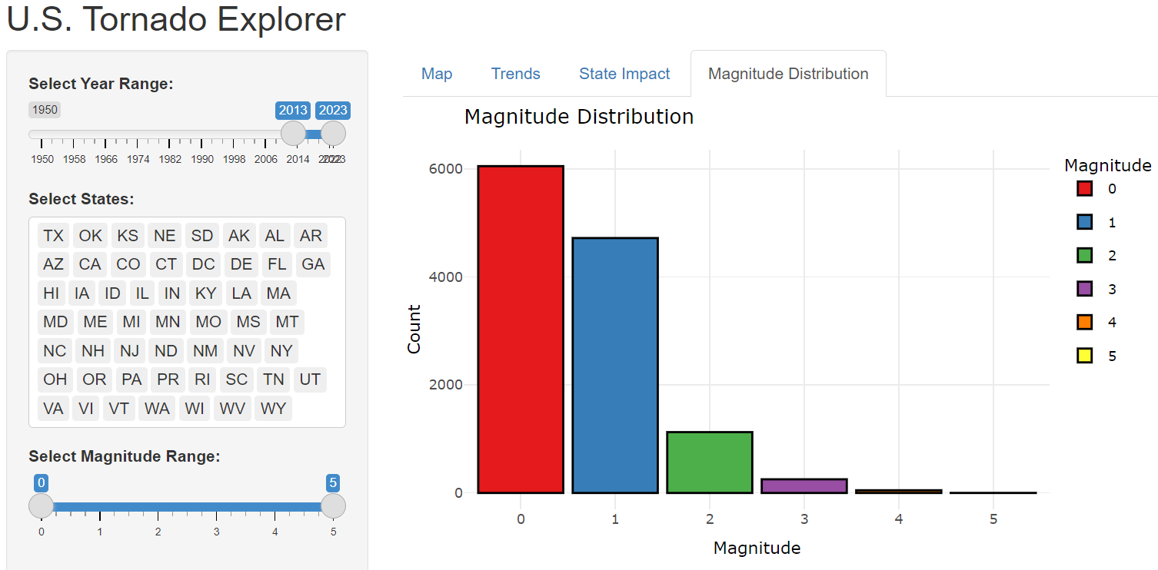
The final tab of the Shiny App includes a bar chart that shows the distribution of tornado reports by magnitude (EF-scale rating).
The graph generated shows the magnitude count for the tornado reports in all States.
This chart is extremely helpful, not only just by displaying the given data, but being a useful tool to help determine how the data can be used.
For this chart the year range being explored is from 2013-2023 for every State that has a tornado report. If we wanted to perform univariate or multivariate analysis using magnitude, we can see that using the higher magnitudes (EF4 and EF5) could possibly be an issue.
Performing linear regression with few data points within a category often reduces the reliability and accuracy of the model. Overfitting is also a concern, especially when EF1 has over 6000 data points and EF5 has just 1 data point.

Slide 10
Conclusion
Based on the charts and graph viewed in this presentation, we can loosely determine a couple of correlations. Comparing number of tornado reports and location as well as location of reports and number of injuries/fatalities.
As mentioned, storms in the southern US states tend to move faster and cause more damage/harm.
Most of these findings displayed by the presented charts/graphs fall in line with what should be predicted by most atmospheric scientists/researchers. How storms form and why storms form continue to have unexplainable aspects; however, forecasting has become more accurate and will continue to improve. Analyzing past climatology data will always be one of our greatest sources of information in hopes of finding answers to those questions that remain unanswered.

Slide 11
Sources
1. Storm Prediction Center. “Severe Weather Maps, Graphics, and Data Page”
Date accessed 7/20/2025
https://www.spc.noaa.gov/wcm/
2. National Weather Service. “Damage Surveys”
Date accessed 7/20/2025
https://www.weather.gov/ama/damagesurveys
3. Storm Prediction Center. “Fujita Tornado Damage Scale”
Data accessed 7/20/2025
https://www.spc.noaa.gov/faq/tornado/f-scale.html
4. Nomura, B. (2025). “Data824 Final Project – Shiny App”
Data accessed 7/22/2025
https://github.com/nomurab/DATA824/tree/main

